Slide 1
FAT File System
Thanh Tung

Slide 2
Contend
Media Structure
FAT File System
Directories
File Operations

Slide 3
Contend
Media Structure
FAT File System
Directories
File Operations

Slide 4
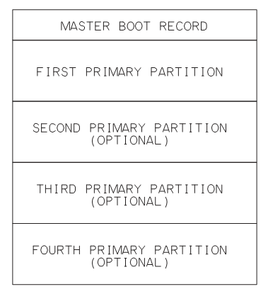
Media Structure
In a disk volume
Master boot record
Partitions
Notes:
- In a disk volume contains master boot record and Partitions

Slide 5
Media Structure
Master boot record
Partition table that defines the locations of partitions.
Executable code
Notes:
- In USB mass storage devices almost contain one partition.

Slide 6
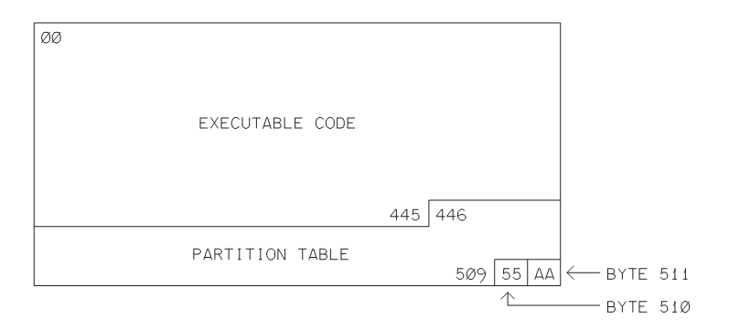
Media Structure
Master boot record
Notes:
In USB mass storage devices almost contain one partition.
The partition table enables defining one or more partitions, or logical volumes, in the storage media. Many devices have just one volume. The partition table in the MBR sector has room for four 16-byte entries that each specify the sectors that belong to a partition. The table is in bytes 446 through 509.
Each partition entry has fields that define the partition’s starting location when addressing via the CHS and LBA methods. The LBA field at byte 8 specifies the starting sector of the partition expressed as an offset from the beginning of the media (the MBR sector). The CHS values are ignored when using LBA. If a partition is bootable, executable code in the MBR may use CHS addresses to locate boot code in the partition.

Slide 7
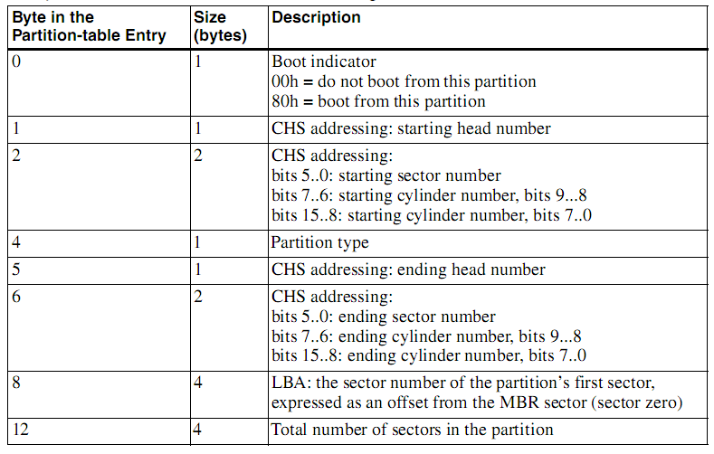
Media Structure
Master boot record
A table entry contains information that enables the master computer to access locations in the storage media.
Notes:
In USB mass storage devices almost contain one partition.
The partition table enables defining one or more partitions, or logical volumes, in the storage media. Many devices have just one volume. The partition table in the MBR sector has room for four 16-byte entries that each specify the sectors that belong to a partition. The table is in bytes 446 through 509.
Each partition entry has fields that define the partition’s starting location when addressing via the CHS and LBA methods. The LBA field at byte 8 specifies the starting sector of the partition expressed as an offset from the beginning of the media (the MBR sector). The CHS values are ignored when using LBA. If a partition is bootable, executable code in the MBR may use CHS addresses to locate boot code in the partition.

Slide 8
Media Structure
In a disk volume
Partitions
Notes:
- In a disk volume contains master boot record and Partitions

Slide 9
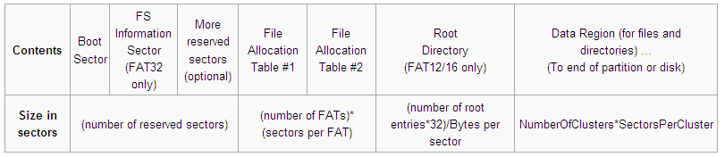
Media Structure
Partition Structure
Notes:
Structure of Partition
One sector usually contain 512 bytes equals to number of bytes in a logical block ( in flash memory).
Fat: File allocation table.
Each FAT contain entries that map to a cluster.
A cluster a number of sectors.
Fatn : n refers to number of bits use in an entry in FAT.
The Reserved sectors. The first reserved sector (sector 0) is the Boot Sector .It includes an area called the BIOS Parameter Block (with some basic file system information, in particular its type, and pointers to the location of the other sections) and usually contains the operating system's boot loader code.
The FAT Region. This typically contains two copies (may vary) of the File Allocation Table for the sake of redundancy checking, although the extra copy is rarely used, even by disk repair utilities. These are maps of the Data Region, indicating which clusters are used by files and directories. In FAT16 and FAT12 they immediately follow the reserved sectors.
The Root Directory Region. This is a Directory Table that stores information about the files and directories located in the root directory. It is only used with FAT12 and FAT16, and imposes on the root directory a fixed maximum size which is pre-allocated at creation of this volume. FAT32 stores the root directory in the Data Region, along with files and other directories, allowing it to grow without such a constraint. Thus, for FAT32, the Data Region starts here.
The Data Region. This is where the actual file and directory data is stored and takes up most of the partition. The size of files and subdirectories can be increased arbitrarily (as long as there are free clusters) by simply adding more links to the file's chain in the FAT. Note however, that files are allocated in units of clusters, so if a 1 KB file resides in a 32 KB cluster, 31 KB are wasted. FAT32 typically commences the Root Directory Table in cluster number 2: the first cluster of the Data Region.
- Boot Sector
The boot sector isn't the first sector on a device. For partitioned devices (such as hard drives), the first sector is the Master Boot Record. On non-partitioned devices (eg. floppy disk) the first sector is the Volume Boot Record.

Slide 10
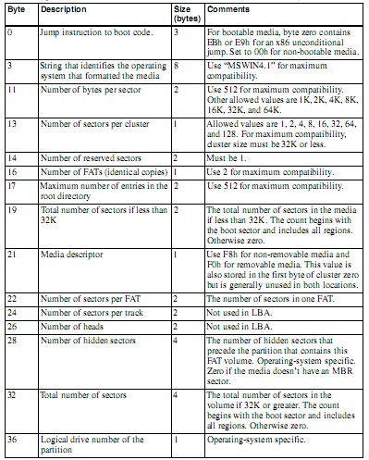
Media Structure
Partition Structure
First 36 byte in Boot sector
Notes:
Details see in USB mass storage designing and programming – Jan alexon

Slide 11
Contend
Media Structure
FAT File System
Directories
File Operations

Slide 12
File Allocation Table
The File Allocation Table (FAT) is a list of entries that each map to one cluster on the partition.
Notes:
A partition is divided up into identically sized clusters, small blocks of contiguous space. Cluster sizes vary depending on the type of FAT file system being used and the size of the partition, typically cluster sizes lie somewhere between 2 KB and 32 KB.
Each file may occupy one or more of these clusters depending on its size; thus, a file is represented by a chain of these clusters (referred to as a singly linked list).
The File Allocation Table (FAT) is a list of entries that map to each cluster on the partition.
The first two entries in a FAT store special values: The first entry contains a copy of the media descriptor (from boot sector, offset 0x15). The remaining 8 bits (if FAT16), or 20 bits (if FAT32) of this entry are 1.
The second entry stores the end-of-cluster-chain marker. The high order two bits of this entry are sometimes, in the case of FAT16 and FAT32, used for dirty volume management: high order bit 1: last shutdown was clean; next highest bit 1: during the previous mount no disk I/O errors were detected.^{[33]}

Slide 13
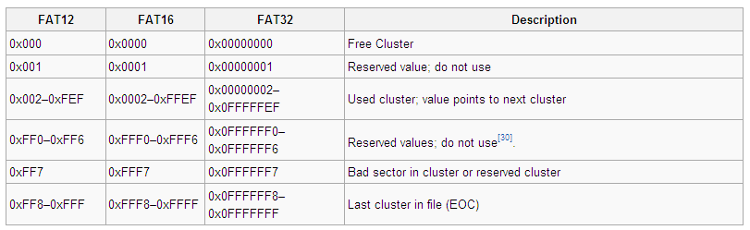
File Allocation Table
FAT entry values
Notes:
A partition is divided up into identically sized clusters, small blocks of contiguous space. Cluster sizes vary depending on the type of FAT file system being used and the size of the partition, typically cluster sizes lie somewhere between 2 KB and 32 KB.
Each file may occupy one or more of these clusters depending on its size; thus, a file is represented by a chain of these clusters (referred to as a singly linked list).
The File Allocation Table (FAT) is a list of entries that map to each cluster on the partition.
The first two entries in a FAT store special values: The first entry contains a copy of the media descriptor (from boot sector, offset 0x15). The remaining 8 bits (if FAT16), or 20 bits (if FAT32) of this entry are 1.
The second entry stores the end-of-cluster-chain marker. The high order two bits of this entry are sometimes, in the case of FAT16 and FAT32, used for dirty volume management: high order bit 1: last shutdown was clean; next highest bit 1: during the previous mount no disk I/O errors were detected.^{[33]}

Slide 14
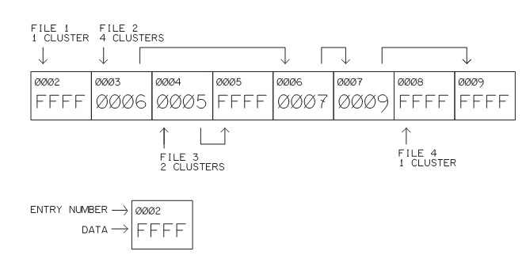
File Allocation Table
FAT entries represent clusters belongs to a file
Notes:
If a file requires two clusters, the FAT entry for the file’s first cluster contains the number of the file’s next cluster and the entry for the second cluster contains an EOC marker. For example, if a file uses clusters 0004h and 0005h in sequence, entry 0004h contains 0005h, and entry 0005h contains an EOC marker.
Reading, writing entries algorisms and finding free cluster can be seen detailed in Mass storage device designing and programming - Jan Alexon document

Slide 15
Contend
Media Structure
FAT File System
Directories
File Operations

Slide 16
Directories
The root directory contains a 32-byte entry for each file in the root directory and each subdirectory directly under the root directory.
Each entry records the name, extension, attributes (archive, directory, hidden, read-only, system and volume), the date and time of creation, the address of the first cluster of the file/directory's data and finally the size of the file/directory.

Slide 17
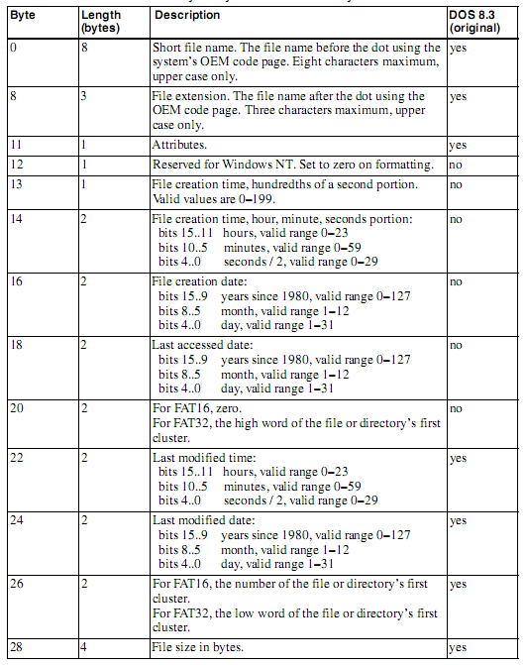
Directories
Fields in an Directory entry
Notes:
- Files and Subdirectories have the same entry prototype.

Slide 18
Directories
Directory Entries
The first two entries in a subdirectory are the dot and dot dot entries:
“ . ”
“ .. ”
Notes:
“.” current directory
“..” upper directory

Slide 19
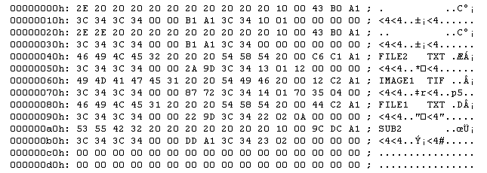
Directories
Directory Entries
Entries in a subdirectory

Slide 20
Directories
The Volume Label Entry
A volume’s root directory contains the one and only volume-label entry.
Notes:
“.” current directory
“..” upper directory
The Reading, writing entries algorism can be seen detailed in Mass storage device designing and programming - Jan Alexon document

Slide 21
Contend
Media Structure
FAT File System
Directories
File Operations

Slide 22
File Operations
Creating a File.
Deleting a File.
Opening a File.
Reading from a File.
Writing to a File.
Closing a File
Notes:
The Reading, writing entries algorism can be seen detailed in Mass storage device designing and programming - Jan Alexon document

Slide 23
File Operations
Creating a File.
Creates a new entry for a file in a directory
Allocates a cluster for the file.
0x0002
File entry
FAT entry
0xffff
0x0002
Free Cluster
Notes:
The Reading, writing entries algorism can be seen detailed in Mass storage device designing and programming - Jan Alexon document

Slide 24
File Operations
Deleting a File.
Search the file’s directory for the entry containing the name of the file to delete.
Save the cluster number from the file’s directory entry.
Mark the directory entry as deleted by storing E5h in the entry’s first byte.
Examine the FAT entry for the saved cluster number. If the entry isn’t an EOC marker, save the cluster number and store 0x0000h in the entry to mark it as available.
Notes:
The Reading, writing entries algorism can be seen detailed in Mass storage device designing and programming - Jan Alexon document

Slide 25
File Operations
Deleting a File.
0002
0003
0005
File entry
(32 bytes)
FAT entry
0x0003
FAT entry
0x0005
FAT entry
0xffff
0002
0003
0005
Cluster
Cluster
Cluster
Notes:
The Reading, writing entries algorism can be seen detailed in Mass storage device designing and programming - Jan Alexon document

Slide 26
File Operations
Deleting a File.
0x0003
0x0005
0002
0003
0005
File entry
(32 bytes)
FAT entry
0x0003
FAT entry
0x0005
FAT entry
0xffff
0x0000
0x0000
0x0000
0xE5
0002
0003
0005
Cluster
Cluster
Cluster
Notes:
The Reading, writing entries algorism can be seen detailed in Mass storage device designing and programming - Jan Alexon document

Slide 27
File Operations
Opening a File.
Retrieves a file’s directory entry, copies information from the entry into a FILE structure.
Reads the file’s first sector into the file structure’s buffer member.
Sets the file structure’s FLAGS member to indicate whether the file is open for reading or writing.
Notes:
The Reading, writing entries algorism can be seen detailed in Mass storage device designing and programming - Jan Alexon document

Slide 28
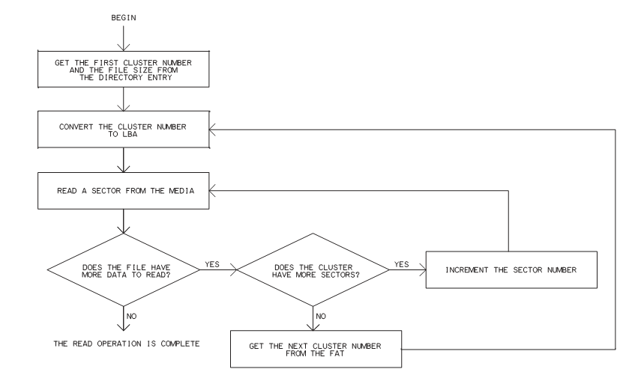
File Operations
Opening a File.
Notes:
The Reading, writing entries algorism can be seen detailed in Mass storage device designing and programming - Jan Alexon document

Slide 29
File Operations
Reading from a File.
Get the file’s size and the number of the file’s first cluster from the directory entry and convert the cluster number to an LBA sector number.
Read data from the cluster’s sector(s). To read more data, get the next cluster number from the current cluster’s FAT entry, convert the cluster number to an LBA sector number, and read the data in the cluster’s sector(s).
Notes:
The Reading, writing entries algorism can be seen detailed in Mass storage device designing and programming - Jan Alexon document

Slide 30
File Operations
Writing to a File.
Allocate a cluster in the FAT, store the cluster number in the file’s directory entry, and convert the cluster number to an LBA sector number.
Write data to the cluster’s sector(s).
To write more data, search the FAT for an available cluster, store the cluster number in the FAT entry for the file’s current cluster, store an EOC.
Update the file’s directory entry.
Notes:
The Reading, writing entries algorism can be seen detailed in Mass storage device designing and programming - Jan Alexon document

Slide 31
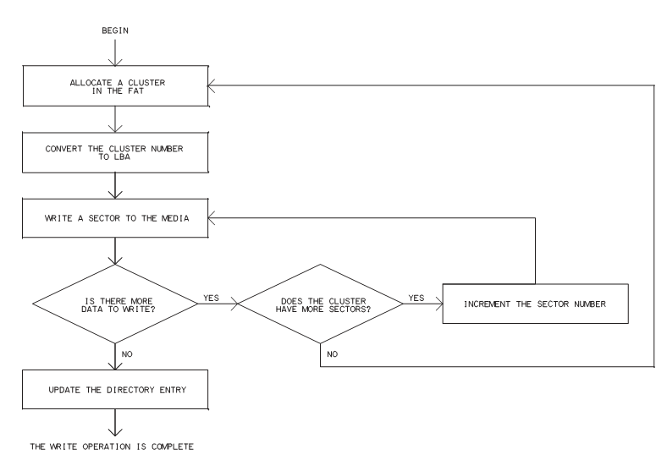
File Operations
Writing to a File.
Notes:
The Reading, writing entries algorism can be seen detailed in Mass storage device designing and programming - Jan Alexon document

Slide 32
File Operations
Closing a File
When finished writing to a file, firmware must update the file’s directory entry.
File entry
(32 bytes)
Notes:
The Reading, writing entries algorism can be seen detailed in Mass storage device designing and programming - Jan Alexon document

Slide 33
Thank for your attentions!

